Slide 1
Probability and Statistics (IT302) 5th August 2020 (11:15AM-11:45AM) Class

Slide 2
Probability Models
Probability models allow us to find the probability of any collection of outcomes.
An event is any collection of outcomes from some chance process. That is, an event is a subset of the sample space. Events are usually designated by capital letters, like A, B, C, and so on.
If A is any event, we write its probability as P(A).
In the dice-rolling example, suppose we define event A as “sum is 5.”
There are 4 outcomes that result in a sum of 5. Since each outcome has probability 1/36, P(A) = 4/36.
Suppose event B is defined as “sum is not 5.” What is P(B)?
P(B) = 1 – 4/36 = 32/36
Source : https://www.goldenvalleyhs.org/apps/pages/index.jsp?uREC_ID=322884&type=u&pREC_ID=740733
The Practice of Statistics, 5th Edition.

Slide 3
Basic Rules of Probability
The probability of any event is a number between 0 and 1.
All possible outcomes together must have probabilities whose sum is exactly 1.
If all outcomes in the sample space are equally likely, the probability that event A occurs can be found using the formula
The probability that an event does not occur is 1 minus the probability that the event does occur.
If two events have no outcomes in common, the probability that one or the other occurs is the sum of their individual probabilities.
Two events A and B are mutually exclusive (disjoint) if they have no outcomes in common and so can never occur together—that is, if P(A and B ) = 0.
Source : https://www.goldenvalleyhs.org/apps/pages/index.jsp?uREC_ID=322884&type=u&pREC_ID=740733
The Practice of Statistics, 5th Edition.

Slide 4
Basic Rules of Probability
We can summarize the basic probability rules more concisely in symbolic form.
Basic Probability Rules
For any event A, 0 ≤ P(A) ≤ 1.
If S is the sample space in a probability model,
P(S) = 1.
In the case of equally likely outcomes,
Complement rule: P(A^{C}) = 1 – P(A)
Addition rule for mutually exclusive events: If A and B are mutually exclusive,
P(A or B) = P(A) + P(B).
Source : https://www.goldenvalleyhs.org/apps/pages/index.jsp?uREC_ID=322884&type=u&pREC_ID=740733
The Practice of Statistics, 5th Edition.

Slide 5
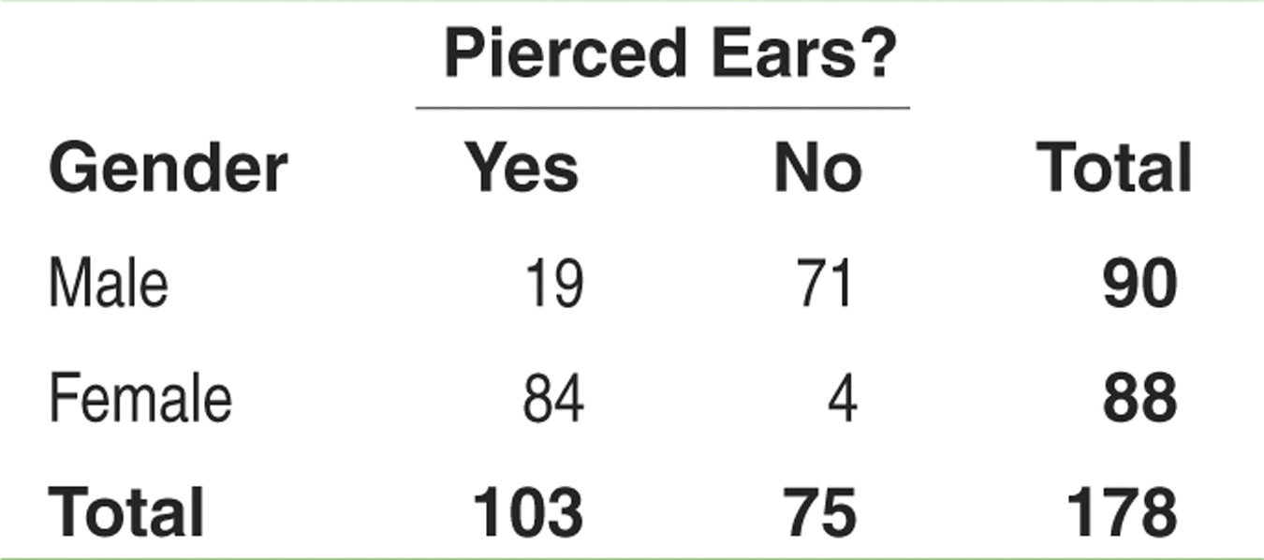
Two-Way Tables and Probability
When finding probabilities involving two events, a two-way table can display the sample space in a way that makes probability calculations easier.
Consider the example on page 309. Suppose we choose a student at random. Find the probability that the student
has pierced ears.
is a male with pierced ears.
is a male or has pierced ears.
Define events A: is male and B: has pierced ears.
(b) We want to find P(male and pierced ears), that is, P(A and B). Look at the intersection of the “Male” row and “Yes” column. There are 19 males with pierced ears. So, P(A and B) = 19/178.
(a) Each student is equally likely to be chosen. 103 students have pierced ears. So, P(pierced ears) = P(B) = 103/178.
(c) We want to find P(male or pierced ears), that is, P(A or B). There are 90 males in the class and 103 individuals with pierced ears. However, 19 males have pierced ears – don’t count them twice!
P(A or B) = (19 + 71 + 84)/178. So, P(A or B) = 174/178
Source : https://www.goldenvalleyhs.org/apps/pages/index.jsp?uREC_ID=322884&type=u&pREC_ID=740733
The Practice of Statistics, 5th Edition.
Notes:
Try Exercise 39

Slide 6
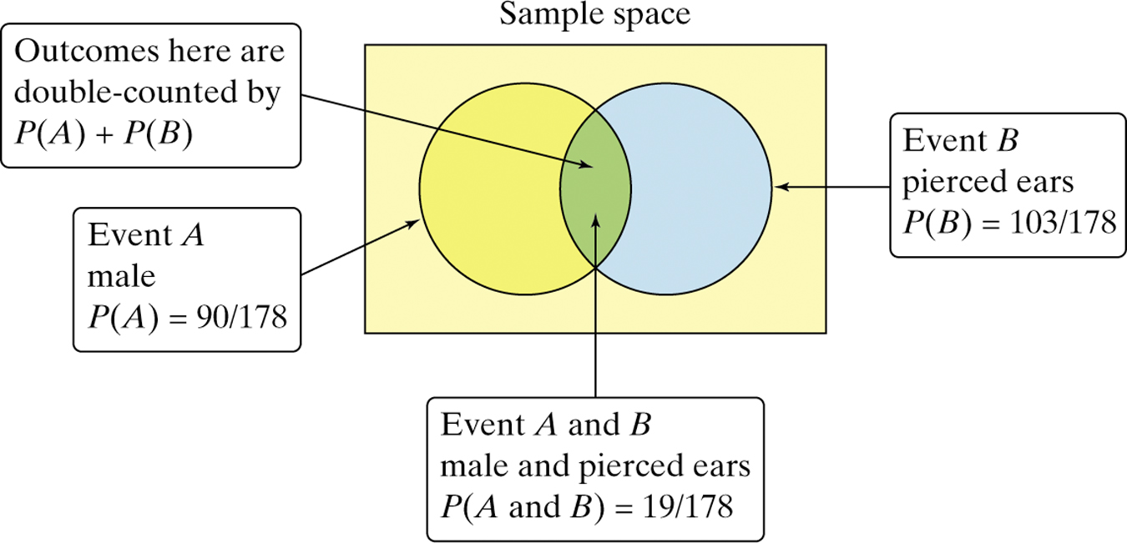
General Addition Rule for Two Events
We can’t use the addition rule for mutually exclusive events unless the events have no outcomes in common.
General Addition Rule for Two Events
If A and B are any two events resulting from some chance process, then
P(A or B) = P(A) + P(B) – P(A and B)
Source : https://www.goldenvalleyhs.org/apps/pages/index.jsp?uREC_ID=322884&type=u&pREC_ID=740733
The Practice of Statistics, 5th Edition.
Notes:
Try Exercise 39

Slide 7
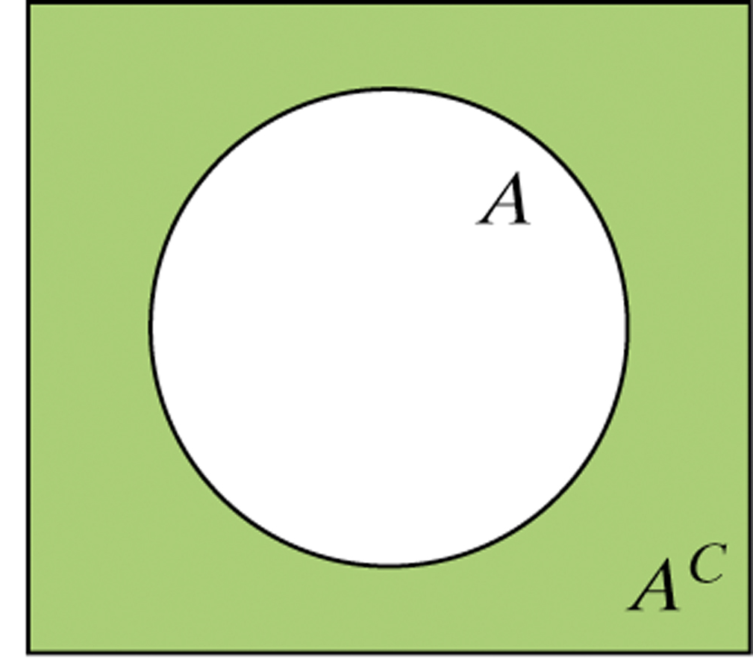
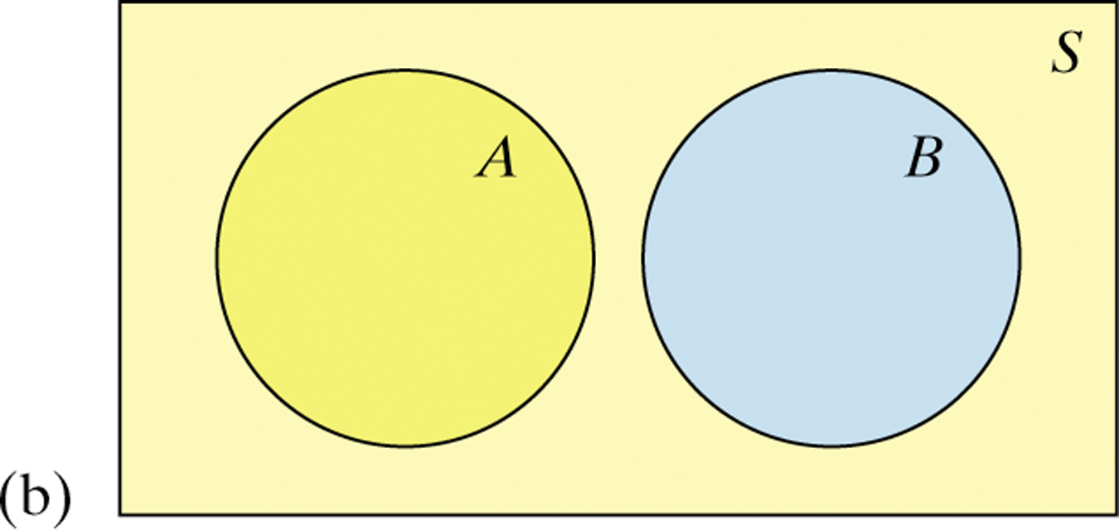
Venn Diagrams and Probability
Because Venn diagrams have uses in other branches of mathematics, some standard vocabulary and notation have been developed.
The complement A^{C} contains exactly the outcomes that are not in A.
The events A and B are mutually exclusive (disjoint) because they do not overlap. That is, they have no outcomes in common.
Source : https://www.goldenvalleyhs.org/apps/pages/index.jsp?uREC_ID=322884&type=u&pREC_ID=740733
The Practice of Statistics, 5th Edition.
Notes:
Try Exercise 39

Slide 8
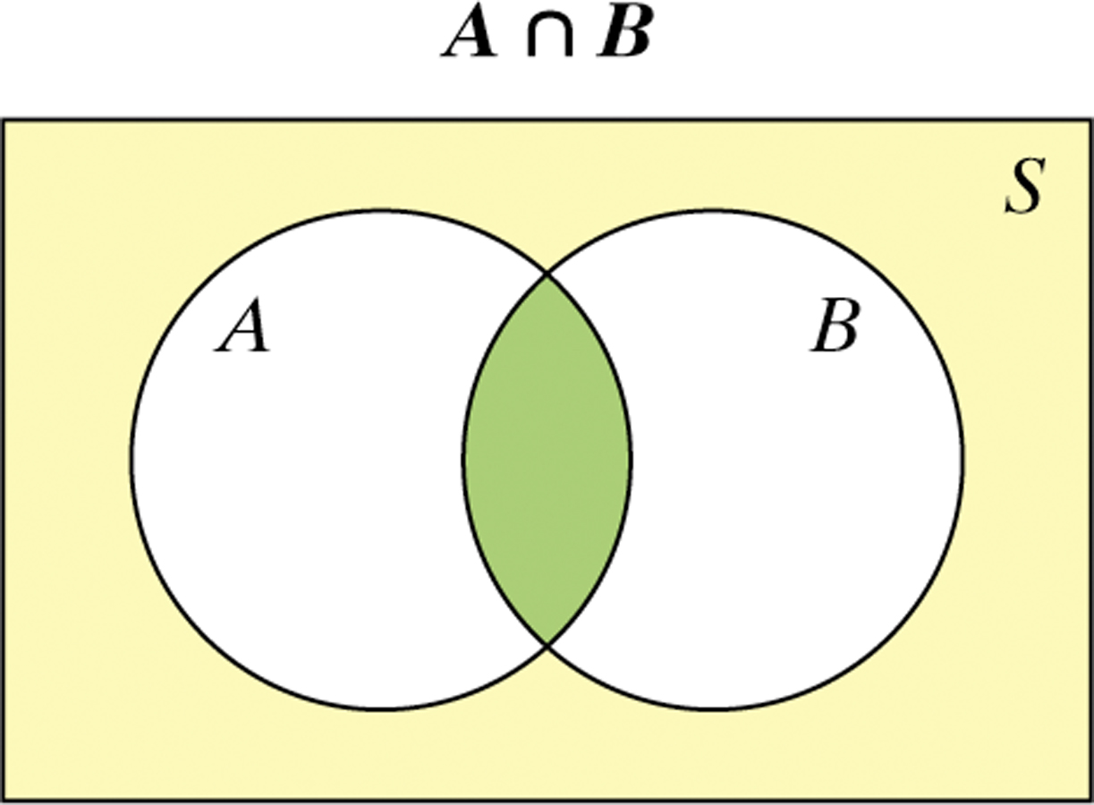
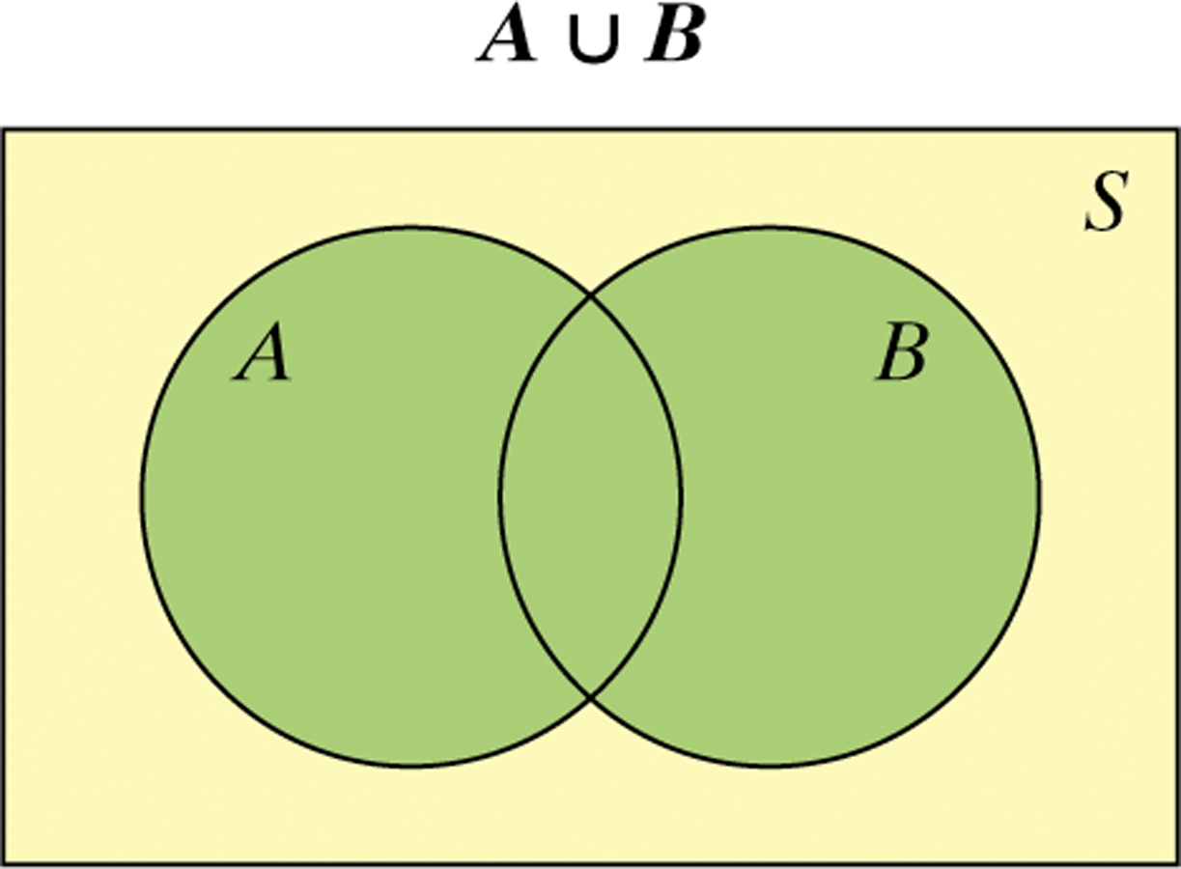
Venn Diagrams and Probability
The intersection of events A and B (A ∩ B) is the set of all outcomes in both events A and B.
The union of events A and B (A ∪ B) is the set of all outcomes in either event A or B.
Hint: To keep the symbols straight, remember ∪ for union and ∩ for intersection.
Source : https://www.goldenvalleyhs.org/apps/pages/index.jsp?uREC_ID=322884&type=u&pREC_ID=740733
The Practice of Statistics, 5th Edition.
Notes:
Try Exercise 39

Slide 9
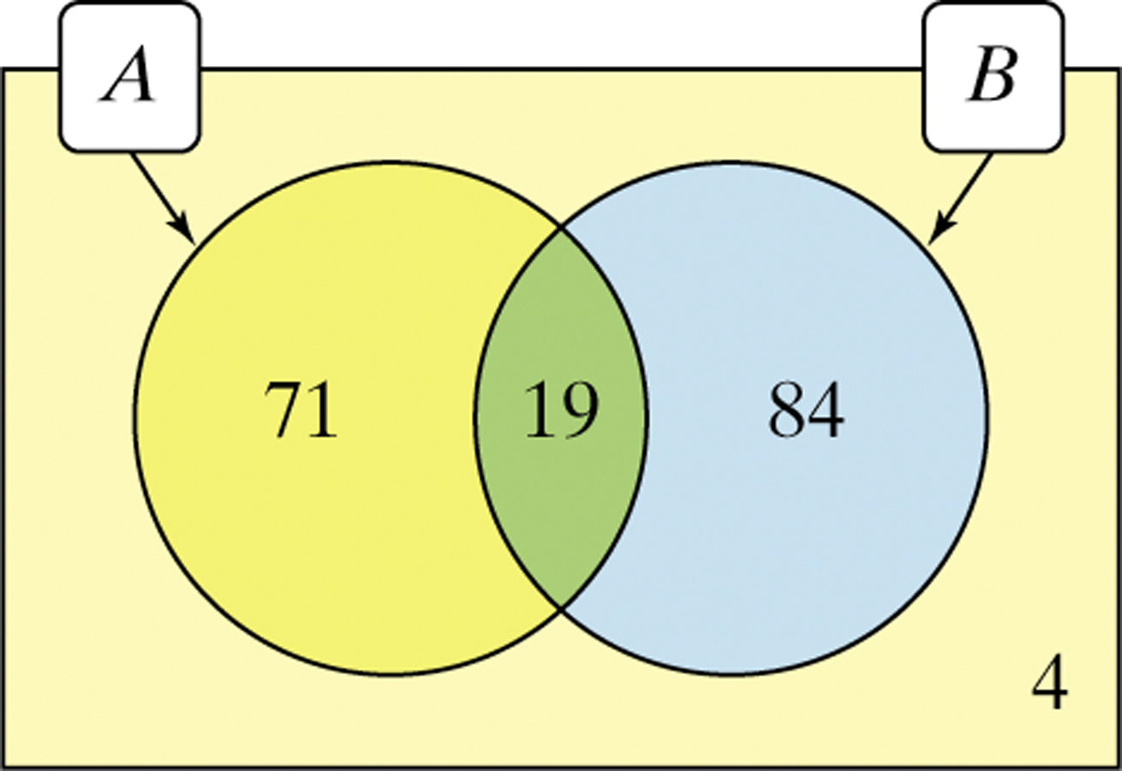
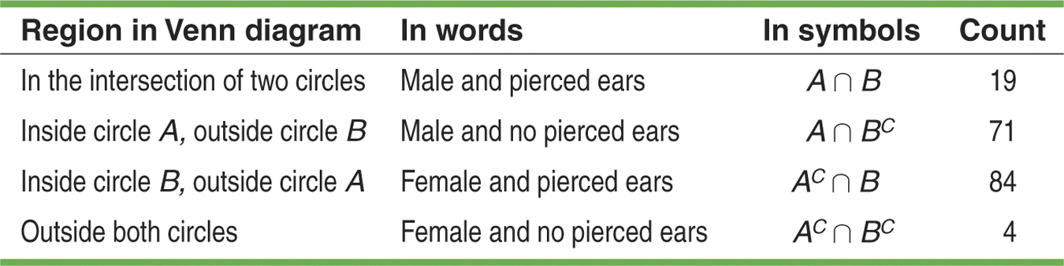
Venn Diagrams and Probability
Recall the example on gender and pierced ears. We can use a Venn diagram to display the information and determine probabilities.
Define events A: is male and B: has pierced ears.
Source : https://www.goldenvalleyhs.org/apps/pages/index.jsp?uREC_ID=322884&type=u&pREC_ID=740733
The Practice of Statistics, 5th Edition.
Notes:
Try Exercise 39

Slide 10
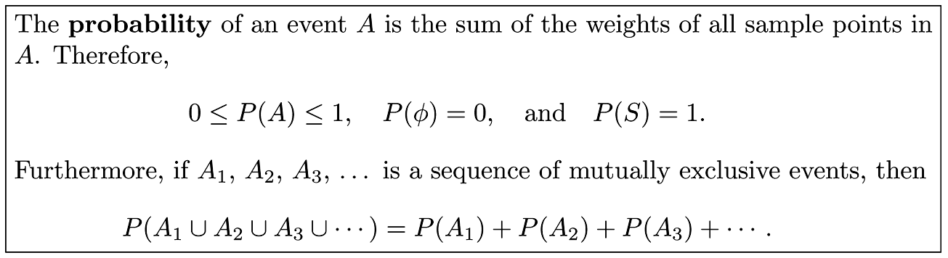
Probability of an Event
To find the probability of an event A, we sum all the probabilities assigned to the sample points in A. This sum is called the probability of A and is denoted by P(A).
The likelihood of the occurrence of an event resulting from such a statistical experiment is evaluated by means of a set of real numbers, called weights or probabilities, ranging from 0 to 1.

Slide 11
Example for Probability of an Event
Example 2.24: A coin is tossed twice. What is the probability that at least 1 head occurs?
Solution : The sample space for this experiment is S = {HH,HT, TH, TT}. If the coin is balanced, each of these outcomes is equally likely to occur. Therefore, we assign a probability of ω to each sample point. Then 4ω = 1, or ω = 1/4. If A represents the event of at least 1 head occurring, then

Slide 12
Example for Probability of an Event
Example 2.25: A die is loaded in such a way that an even number is twice as likely to occur as an odd number. If E is the event that a number less than 4 occurs on a single toss of the die, find P(E).
Solution: The sample space is S = {1, 2, 3, 4, 5, 6}. We assign a probability of w to each odd number and a probability of 2w to each even number. Since the sum of th probabilities must be 1, we have 9w = 1 or w = 1/9. Hence, probabilities of 1/9 and 2/9 are assigned to each odd and even number, respectively. Therefore

Slide 13
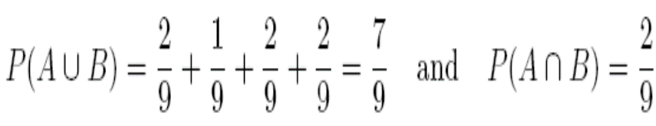
Example for Probability of an Event
Example 2.26: In Example 2.25, let A be the event that an even number turns up and let B be the event that a number divisible by 3 occurs. Find P(A ∪ B) and P(A ∩ B).
Solution: For the events A={2,4,6} and B={3,6}, we have A∪B ={2,3,4,6} and A∩B = {6}.
By assigning a probability of 1/9 to each odd number and 2/9 to each even number, we have
If the sample space for an experiment contains N elements, all of which are equally likely to occur, we assign a probability equal to 1/N to each of the N points. The probability of any event A containing n of these N sample points is then the ratio of the number of elements in A to the number of elements in S.

Slide 14
Rule 2.3

Slide 15
Additive Rules
Additive Rule applies to unions of events.
If A and B are two events, then P(A ∪ B) = P(A) + P(B) − P(A ∩ B).
Proof : Consider the Venn diagram in Figure 2.7. The P(A ∪ B) is the sum of the probabilities of the sample points in A ∪ B. Now P(A) + P(B) is the sum of all the probabilities in A plus the sum of all the probabilities in B. Therefore, we have added the probabilities in (A ∩ B) twice. Since these probabilities add up to P(A ∩ B), we must subtract this probability once to obtain the sum of the probabilities in A ∪ B.

Slide 16
Corollary
If A and B are mutually exclusive, then P(A ∪ B) = P(A) + P(B).
If A and B are mutually exclusive, A∩B = 0 and then P(A∩B) = P(φ) = 0.
If A₁, A₂, . . . , A_{n} are mutually exclusive, then
P(A₁ ∪ A₂ ∪ ・ ・ ・ ∪ A_{n}) = P(A₁) + P(A₂) + ・ ・ ・ + P(A_{n}).
If A₁, A₂, . . . , A_{n} is a partition of sample space S, then
P(A₁ ∪ A₂ ∪ ・ ・ ・ ∪ A_{n}) = P(A₁) + P(A₂) + ・ ・ ・ + P(A_{n}) = P(S) = 1.
Theorem 2.8
For three events A, B, and C,
P(A ∪ B ∪ C) = P(A) + P(B) + P(C)− P(A ∩ B) − P(A ∩ C) − P(B ∩ C) + P(A ∩ B ∩ C).

Slide 17
Additive Rule Example
Example 2.29: John is going to graduate from an industrial engineering department in a university by the end of the semester. After being interviewed at two companies he likes, he assesses that his probability of getting an offer from company A is 0.8, and his probability of getting an offer from company B is 0.6. If he believes that the probability that he will get offers from both companies is 0.5, what is the probability that he will get at least one offer from these two companies?
Solution : Using the additive rule, we have P(A∪B)=P(A)+P(B)−P(A∩B)=0.8 + 0.6 − 0.5 = 0.9.

Slide 18
Additive Rule Example
Example 2.31: If the probabilities are, respectively, 0.09, 0.15, 0.21, and 0.23 that a person purchasing a new automobile will choose the color green, white, red, or blue, what is the probability that a given buyer will purchase a new automobile that comes in one of those colors?
Solution : Let G, W, R, and B be the events that a buyer selects, respectively, a green, white, red, or blue automobile. Since these four events are mutually exclusive, the probability is P(G ∪W ∪ R ∪ B) = P(G) + P(W) + P(R) + P(B)= 0.09 + 0.15 + 0.21 + 0.23 = 0.68.

Slide 19
Theorem 2.9
Theorem 2.9: If A and A are complementary events, then P(A) + P(AꞋ) = 1.
Proof : Since A ∪ A = S and the sets A and A are disjoint, 1 = P(S) = P(A ∪ AꞋ) = P(A) + P(AꞋ).
Example
Example 2.32: If the probabilities that an automobile mechanic will service 3, 4, 5, 6, 7, or 8 or more cars on any given workday are, respectively, 0.12, 0.19, 0.28, 0.24, 0.10, and 0.07, what is the probability that he will service at least 5 cars on his next day at work?
Solution : Let E be the event that at least 5 cars are serviced. Now, P(E) = 1 − P(E), where E is the event that fewer than 5 cars are serviced. Since P(E) = 0.12 + 0.19 = 0.31, it follows from Theorem 2.9 that P(E) = 1 − 0.31 = 0.69.

Slide 20
Exercise
Question 2.51 A box contains 500 envelopes, of which 75 contain $100 in cash, 150 contain $25, and 275 contain $10. An envelope may be purchased for $25. What is the sample space for the different amounts of money? Assign probabilities to the sample points and then find the probability that the first envelope purchased contains less than $100.
Solution : S = {$10, $25, $100} with weights 275/500 = 11/20, 150/500 = 3/10, and 75/500 = 3/20, respectively. The probability that the ﬁrst envelope purchased contains less than $100 is equal to 11/20 + 3/10 = 17/20

Slide 21
Exercise
Question 2.55 If each coded item in a catalog begins with 3 distinct letters followed by 4 distinct nonzero digits, find the probability of randomly selecting one of these coded items with the first letter a vowel and the last digit even.
Solution: By Theorem 2.2, there are N = (26)(25)(24)(9)(8)(7)(6) = 47,174,400 possible ways to code the items of which n = (5)(25)(24)(8)(7)(6)(4) = 4,032,000 begin with a vowel and end with an even digit. Therefore, n/N= 10/117.

Slide 22
Exercise
Question 2.57: If a letter is chosen at random from the English alphabet, find the probability that the letter
is a vowel exclusive of y;
is listed somewhere ahead of the letter j;
is listed somewhere after the letter g.
Solution :
Since 5 of the 26 letters are vowels, we get a probability of 5/26.
Since 9 of the 26 letters precede j, we get a probability of 9/26.
Since 19 of the 26 letters follow g, we get a probability of 19/26.

Slide 23
Exercise
Question 2.64: Interest centers around the life of an electronic component. Suppose it is known that the probability that the component survives for more than 6000 hours is 0.42. Suppose also that the probability that the component survives no longer than 4000 hours is 0.04.
(a) What is the probability that the life of the component is less than or equal to 6000 hours?
(b) What is the probability that the life is greater than 4000 hours?
Solution : (a) 1 − 0.42 = 0.58;
(b) 1 − 0.04 = 0.96.

Slide 24
Exercise
Question 2.63: According to Consumer Digest (July/August 1996), the probable location of personal computers (PC) in the home is as follows: Adult bedroom: 0.03,
Child bedroom: 0.15, Other bedroom: 0.14, Office or den: 0.40, Other rooms: 0.28
(a) What is the probability that a PC is in a bedroom?
(b) What is the probability that it is not in a bedroom?
Solution :
0.32 (0.03+0.15+0.14)
0.68 (1-0.32)

Slide 25
What is Conditional Probability?
The probability we assign to an event can change if we know that some other event has occurred. This idea is the key to many applications of probability.
When we are trying to find the probability that one event will happen under the condition that some other event is already known to have occurred, we are trying to determine a conditional probability.
The probability that one event happens given that another event is already known to have happened is called a conditional probability.
Suppose we know that event A has happened. Then the probability that event B happens given that event A has happened is denoted by P(B | A).
Read | as “given that” or “under the condition that”
Source : https://www.goldenvalleyhs.org/apps/pages/index.jsp?uREC_ID=322884&type=u&pREC_ID=740733
The Practice of Statistics, 5th Edition.

Slide 26
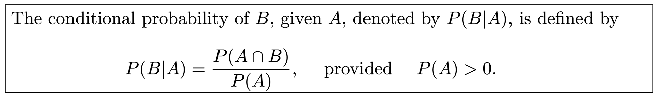
Definition of Conditional Probability
The probability of an event B occurring when it is known that some event A has occurred is called a Conditional Probability and is denoted by P(B|A).
The symbol P(B|A) is usually read “the probability that B occurs given that A occurs” or simply “the probability of B, given A.”

Slide 27
Calculating Conditional Probabilities
Calculating Conditional Probabilities
To find the conditional probability P(A | B), use the formula
The conditional probability P(B | A) is given by
Source : https://www.goldenvalleyhs.org/apps/pages/index.jsp?uREC_ID=322884&type=u&pREC_ID=740733
The Practice of Statistics, 5th Edition.

Slide 28
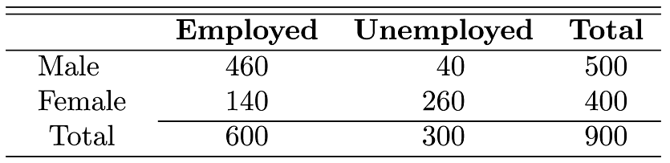
As an additional illustration, suppose that our sample space S is the population of adults in a small town who have completed the requirements for a college degree. We shall categorize them according to gender and employment status. The data are given in Table 2.1.
Table 2.1: Categorization of the Adults in a Small Town
One of these individuals is to be selected at random for a tour throughout the country to publicize the advantages of establishing new industries in the town. We shall be concerned with the following events: M: a man is chosen, E: the one chosen is employed. Using the reduced sample space E, we find that P(M|E) =460/600 =23/30
.

Slide 29
Continuation from Previous Slide

Slide 30
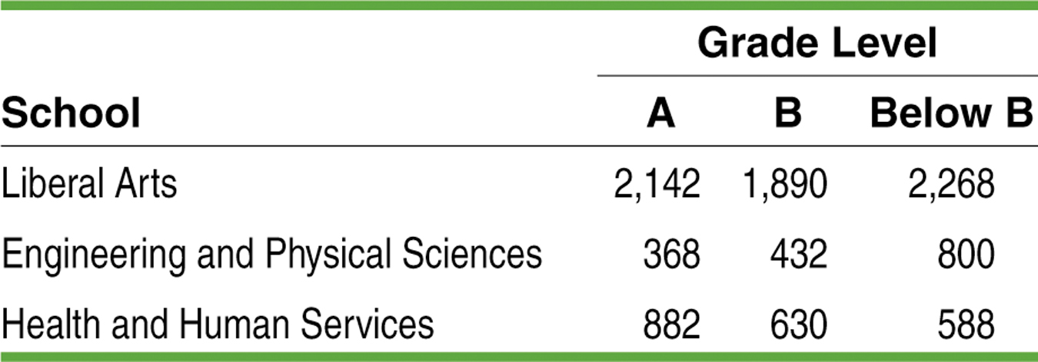
Calculating Conditional Probabilities
Consider the two-way table on page 321 of “The Practice of Statistics, 5th Edition”
Define events E: the grade comes from an Engineering and Physical Science (EPS) Course and
L: the grade is lower than a B.
Total
6300
1600
2100
Total 3392 2952 3656 10000
Find P(L)
Find P(E | L)
Find P(L | E)
P(L) = 3656 / 10000 = 0.3656
P(E | L) = 800 / 3656 = 0.2188
Source :
https://www.goldenvalleyhs.org/apps/pages/index.jsp?uREC_ID=322884&type=u&pREC_ID=740733
The Practice of Statistics, 5th Edition.
P(L| E) = 800 / 1600 = 0.5000
Notes:
Try Exercise 39

Slide 31
The General Multiplication Rule
General Multiplication Rule
The probability that events A and B both occur can be found using the general multiplication rule
P(A ∩ B) = P(A) • P(B | A)
where P(B | A) is the conditional probability that event B occurs given that event A has already occurred.
In words, this rule says that for both of two events to occur, first one must occur, and then given that the first event has occurred, the second must occur.
Source : https://www.goldenvalleyhs.org/apps/pages/index.jsp?uREC_ID=322884&type=u&pREC_ID=740733
The Practice of Statistics, 5th Edition.

Slide 32
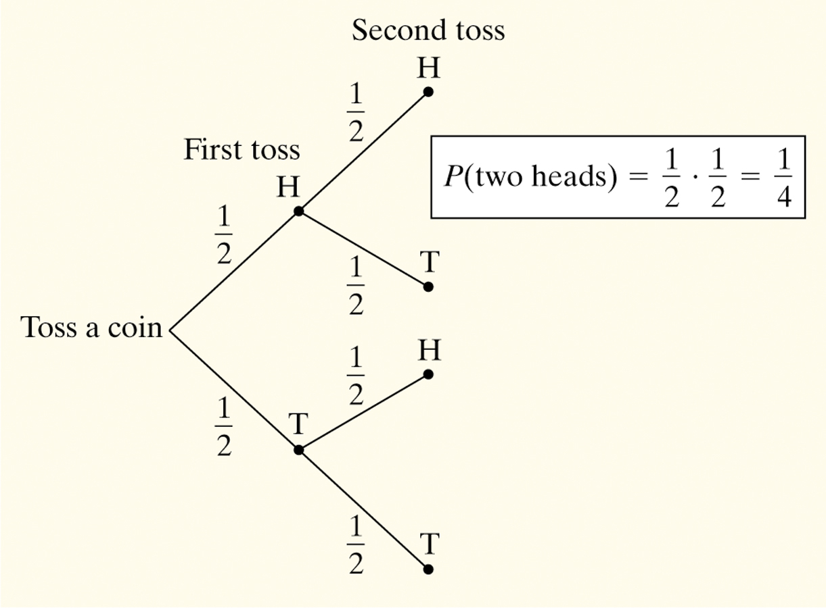
Tree Diagrams
The general multiplication rule is especially useful when a chance process involves a sequence of outcomes. In such cases, we can use a tree diagram to display the sample space.
Consider flipping a coin twice.
What is the probability of getting two heads?
Sample Space:
HH HT TH TT
So, P(two heads) = P(HH) = 1/4
Source : https://www.goldenvalleyhs.org/apps/pages/index.jsp?uREC_ID=322884&type=u&pREC_ID=740733
The Practice of Statistics, 5th Edition.

Slide 33
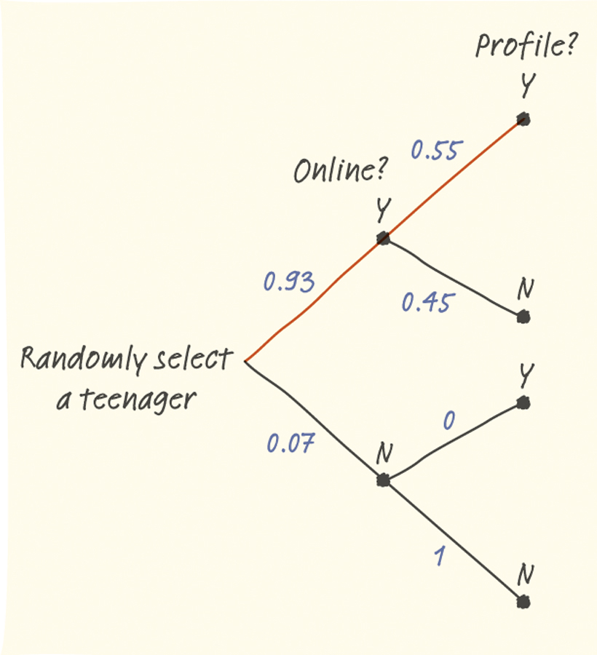
Example: Tree Diagrams
The Pew Internet and American Life Project finds that 93% of teenagers (ages 12 to 17) use the Internet, and that 55% of online teens have posted a profile on a social-networking site.
What percent of teens are online and have posted a profile?
51.15% of teens are online and have posted a profile.
Source : https://www.goldenvalleyhs.org/apps/pages/index.jsp?uREC_ID=322884&type=u&pREC_ID=740733
The Practice of Statistics, 5th Edition.

Slide 34
Exercise
Question 2.73: If R is the event that a convict committed armed robbery and D is the event that the convict pushed dope, state in words what probabilities are expressed by
P(R|D)
P(DꞋ|R)
P(RꞋ|DꞋ)
Solution :
The probability that a convict who pushed dope, also committed armed robbery.
The probability that a convict who committed armed robbery, did not push dope.
The probability that a convict who did not push dope also did not commit armed robbery.

Slide 35
Exercise
Question 2.74: A class in advanced physics is composed of 10 juniors, 30 seniors, and 10 graduate students. The final grades show that 3 of the juniors, 10 of the seniors, and 5 of the graduate students received an “AA” for the course. If a student is chosen at random from this class and is found to have earned an “AA”, what is the probability that he or she is a senior?
Solution : P (S |A) = 10/18 = 5/9.

Slide 36
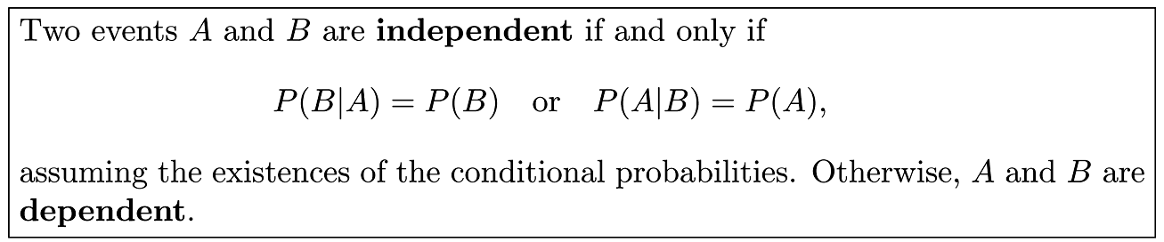
Independent Events
Theorem 2.10
The probability that both A and B occur is equal to the probability that A occurs multiplied by the conditional probability that B occurs, given that A occurs. Since the events A ∩ B and B ∩ A are equivalent, it follows from Theorem 2.10 that we can also write
P(A ∩ B) = P(B ∩ A) = P(B)P(A|B).
In other words, it does not matter which event is referred to as A and which event is referred to as B.

Slide 37
Example
Example 2.36: Suppose that we have a fuse box containing 20 fuses, of which 5 are defective. If 2 fuses are selected at random and removed from the box in succession without replacing the first, what is the probability that both fuses are defective?
Solution : We shall let A be the event that the first fuse is defective and B the event that the second fuse is defective; then we interpret A ∩ B as the event that A occurs and then B occurs after A has occurred. The probability of first removing a defective fuse is 1/4; then the probability of removing a second defective fuse from the remaining 4 is 4/19. Hence,

